Slide 1

TEXT ENCRYPTION USING VARIOUS ALGORTHIMS
S SIVA KARTHIK REDDY -2010030329
E.R SUMANTH -2010030051
K.SNEHITH-2010030341

Slide 2
Abstract
This presentation contains the details of the project ‘text encryption using various algorithms’.
Text-encryption is a process in which the message send by the sender is encrypted so that only receiver can understand the message.
Encryption converts data into scrambled text. The unreadable text can only be decoded with a secret key.
The decoded text can be read by the receiver which maintains the security

Slide 3
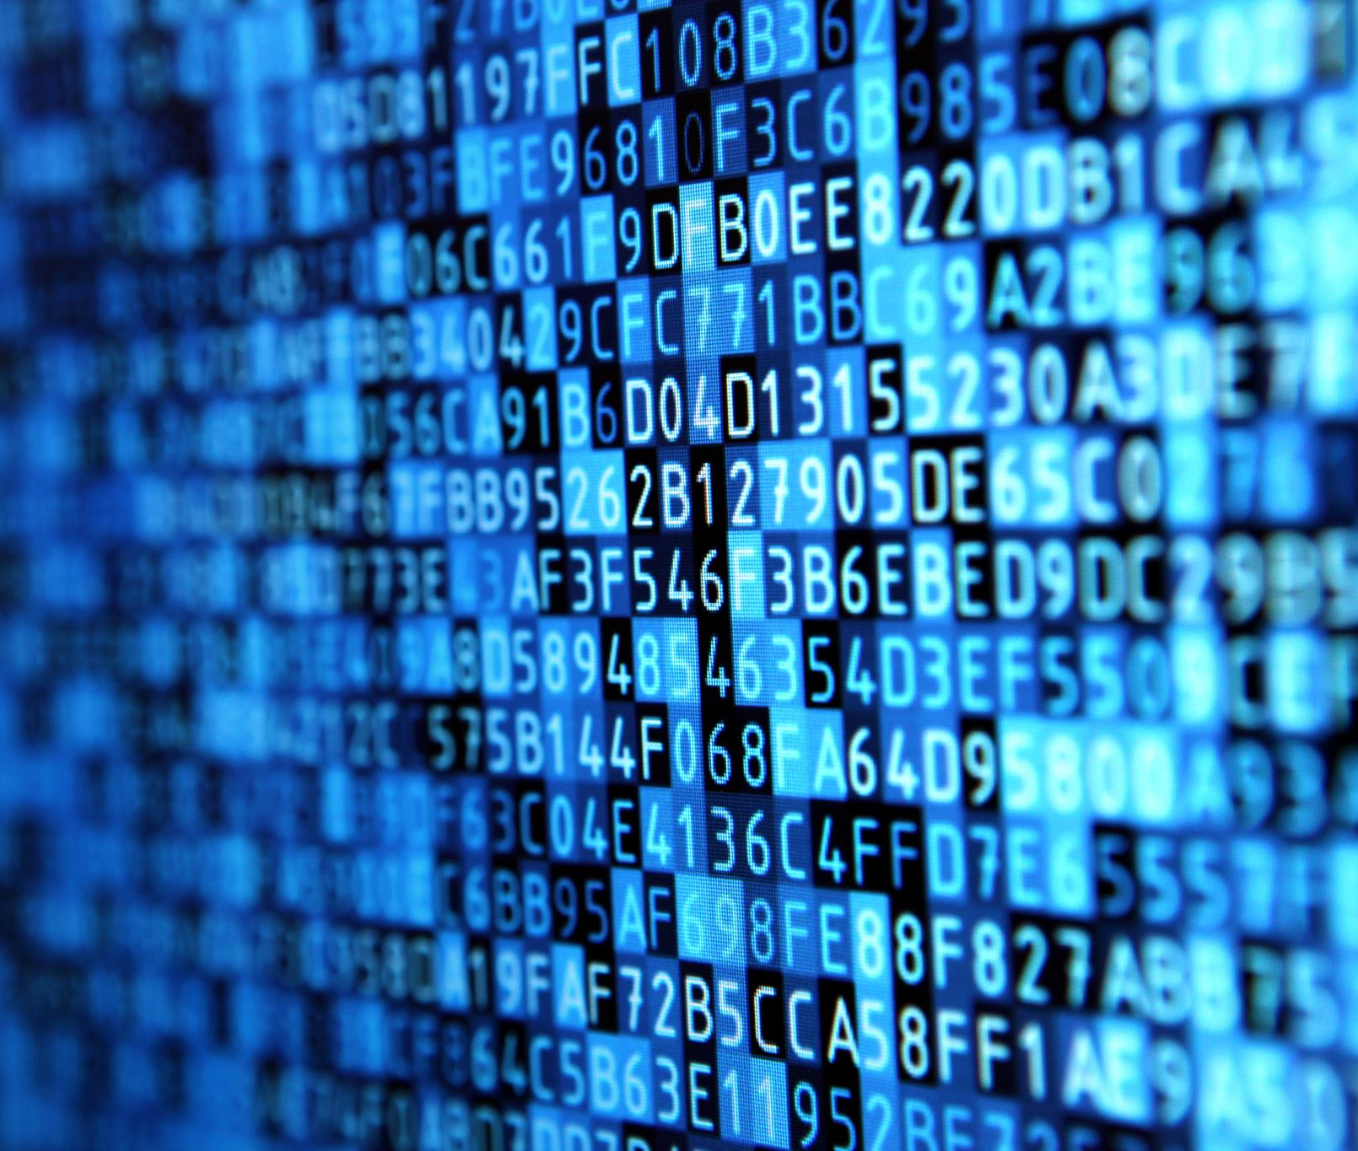
Introduction
Cryptography is a science of secret writing. It is the art of protecting the information by transforming it into an unreadable format in which a message can be concealed from reader and only the intended recipient will be able to convert it into original text. Its main goal is to keep the data secure from unauthorized access. Data can be read and understood without any special measures is called plaintext. The method of disguising plaintext in such a way as to hide its substances is called encryption. Encrypting plaintext results in unreadable gibberish called ciphertext.

Slide 4
Key words
Encryption
Public key
Secret key
Cypher
Bit shift

Slide 5
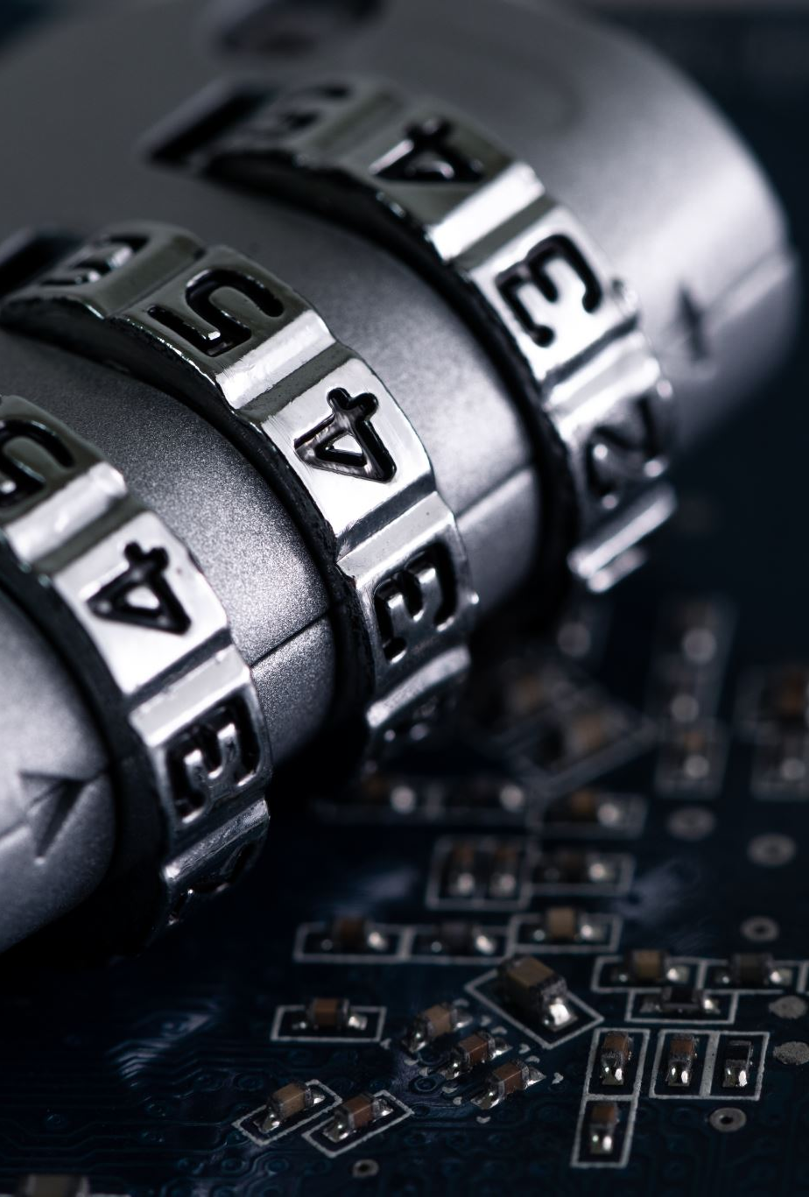
Methods
AES
RC4
RSA
ELIPTIC CURVE
Diffie-Hellman

Slide 6
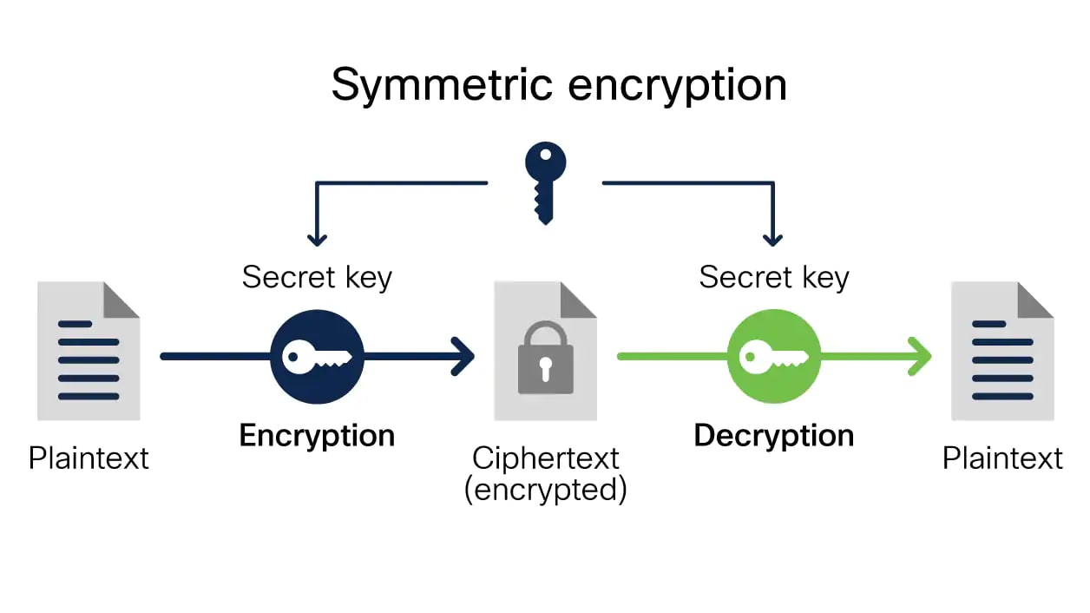
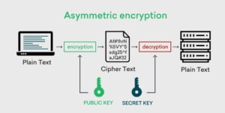
ALGORTHIMS

Slide 7
Literature review
TILTLE OF THE DOCUMENTATION | METHODS USED | PROS | CONS
A Survey on Symmetric Key Encryption Algorithms | AES,DES,TRIPLEDES, BLOWFISH | Uses less memory and require low processing power | Less secured
Comparison of Asymmetric Algorithms in Cryptography | RSA, Elliptic curve, OEAP | Asymmetric encryption does not require the two parties to securely share a secret key before sending encrypted messages. This makes it possible to securely communicate with anyone as long as you have their private key. | Requires so much time then symmetric

Slide 8

Conclusion
Due to increase in rapid technology many people are sending messages through various platforms but due to heavy risk of stealing confidential information many people are in fear of their information being stolen that’s why the we need text encryption so that only the send and receiver can understand what is in that message.

Slide 9
THANK YOU

